Slide 1
Pediatric Feeding: Toddlerhood and Beyond
Notes:
Picture removed – not necessary

Slide 2
Objectives:
At the conclusion of this module, the learner will be able to:
List one gross motor milestone that parallels the oral motor milestone of normal development at 6 months, 7-9 months, and 12-14 months
Name three different medical diagnoses that could potentially require feeding therapy
Describe two different therapeutic approaches that can be used in feeding therapy
List two different therapeutic activities to implement in feeding therapy

Slide 3
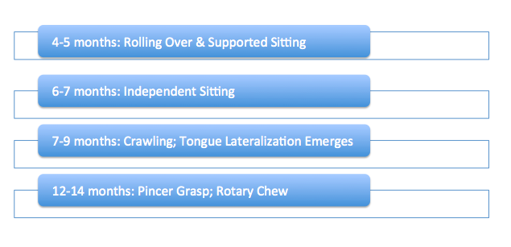
Review of Normal Development
Motor Development
Postpartum:
If they are not sitting, they are not munching. If they are not crawling, do not expect lateralization.
; Munching pattern
Morris & Klein, 1987

Slide 4
REMEMBER…
SENSORY DRIVES MOTOR
“Input”
Before
“Output”
Positive Feedback
Mastery
Repetition
New Trial
Negative Feedback
STOP/
REFUSAL
Repetition
New Trial
VS

Slide 5
Why Feeding Therapy?
- Be ready to listen to their stories and find empathy.
- Be an integral part of their team on their way to finding out what could be going on with their child.
- Be one of the people on a team who helps bring back some sanity to their situation. ☺

Slide 6
Who Can Benefit?
Etiologies
Oral Motor Delay/
Difficulties
Neurological
Anatomical/ Structural
Genetics
Secondary to Systemic Illness
Psychosocial Behavioral
Medical Trauma

Slide 7
Under the Microscope…
Feeding is a multi-system, coordinated event that involves all organs, muscles, and senses.
Breathing is the body’s first priority. We want to feel good!
Skills to eat must come first. If there is a negative feedback loop,
skills will not be developed, and no matter how “hungry” they are,
they will not eat.
If a child is not eating, there is a REASON. Therapy may help
address some areas, but will not fix the problem.
Groher & Crary, 2015

Slide 8
What Does That Look Like?
Behavioral
Sensory
Someone who protests food because of a negative past experience or medical problem that is now resolved
Usually stemming from a medical problem that has interrupted their normal sensory development
Children are most often a combination of both. They may have had sensory system interruption from a past medical issue which then becomes behavioral.
Notes:
Changed picture to powerpoint clip art

Slide 9
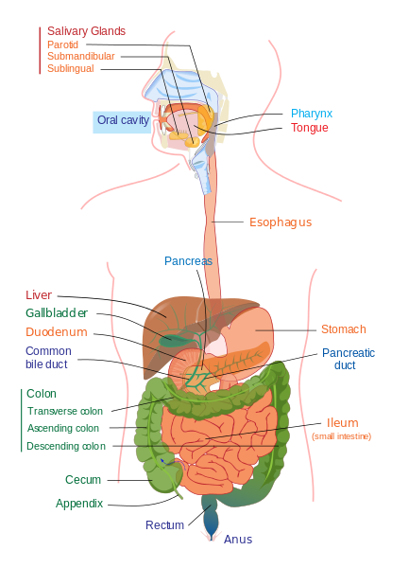
… Asking Good Questions
Because the GI system is connected from oral cavity to anus, some good questions to ask that may not be on your intake form:
How were bottle feedings?
Spit-up or projectile vomiting?
Were they upset when they spit?
How do they stool? What does it look like?
How is weight gain? Is it an issue?
Any signs or symptoms of reflux?
Any sign of bloody or mucousy stools?
Any apparent eczema on the skin?
Photo Courtesy of: LadyofHats

Slide 10
Approaches to Consider…
Behavior Modification | Oral Sensory
Very structured | Child-lead exploration
Two main components | Steps to scaffold as the child is ready
Utilized in in-patient programs due to time | Sensory-driven, learning through play
Incentives to scaffold and trial new things | Focuses on the feeding relationship
Addison et al., (2012); Benson, Parke, Gannon, & Munoz, (2013); Grey, D’Andre, & Westlake, (2010)

Slide 11
BEHAVIORAL MODIFICATION
Positive Reinforcement
Active Ignoring
BE CONSISTENT!
Because they will NOT be.
Reinforcements MUST be motivating – this can look like a toy, a game, a movie, the Ipad, the tv, and most importantly, simply your/the caregiver’s interaction! The caregiver is FUN. Caregivers need to know that if they are having fun and that is taken away, the child will most definitely want the “fun” back.
When a child refuses, active ignoring comes into play. The child is given no attention to unmet requirements. If you’re feeding, the caregiver turns around, your tone changes, you can turn and play by yourself, no eye contact is given. Stoically, offer the requirement again. As soon as the child accepts, praise big and change right back to the happiest of tones!
Photos Courtesy of:
https://www.pexels.com/
Elliott & Clawson, 2014

Slide 12
BEHAVIORAL MODIFICATION
Absolutely no grazing! Studies show grazing is a great way to lose weight and should be utilized in cases of obesity, not failure to thrive (FTT).
Feed in the same place every day.
Make the duration of meals the same and the structure of meals the same.
Control the environment (as best as can be done). You want it to be non-distracting, keeping things out of reach.
Offer non-preferred (new) foods in combination with preferred foods.
Two bites of the preferred and 1 of the non-preferred.
Set a timer and have parents do this too, especially if their child is going to refuse a good amount at first.
When the meal is over, it’s over.
Never force-feed!

Slide 13
Oral Sensory Approach: STEPS to Eating
TASTE
EAT
TOUCH
Learning through play – A safe, fun, and exploratory environment!
EAT
SMELL
INTERACT
TOLERATE
Adapted from The Sequential Oral Sensory Approach to Feeding by Dr. Kay Toomey
Clipart Courtesy of: Clip-art Library

Slide 14
GETTING STARTED…
If your patient only eats pretzels, start with → PRETZELS! Whichever approach you’re using, it’s important the child feels comfortable and confident. Scaffold or branch out from there. Do this by:
SHAPE COLOR TEXTURE

Slide 15
Positioning Them For Greatness
Sometimes it’s just a session about getting seated…
Involve your friendly OT to allow for physical limitations or sensory preferences
1. Sit them down, set a timer, play!
2. Timer goes off, they get up!
Repeat step 1 and 2 until the child is okay with this routine.

Slide 16
Routines
Routine
Stick to a routine so children can learn to anticipate, and never underestimate the power of cleaning up and throwing unwanted food in the trash! Sometimes, this is our best work.
Set up
Sensory activity (bubbles, etc.)
Seating
Distribution of plates, cups, utensils
Clean-up/wash-up

Slide 17
To Say Or Not To Say
Commands Vs. Permission | No Arguing | No Bribery/Do It For…
Parents naturally ask questions, it’s in our nature. | Keep emotions in check. | Children need to decide to eat for themselves.
If you ask questions, the answer is usually “no”. Give permission. | Children perceive their environment from caregivers. | Eat your broccoli and I’ll give you a gummy bear – actually works against you.
Do not give them a choice, make a suggestion (oral sensory). | If you panic, they do too. If you get frustrated, they do too. | Research shows the child ends up hating option 1 even more
Or give commands sternly. (BMOD) | Keep a flat affect until a reward is given (BMOD) or stay calm and happy – It’s feeding time! (SOS) | They just appease you to get to the more highly desired food.
If you ask questions, it leads to arguing. |  | Positive feedback they feel from the food and from the interaction will help drive positivity from food.
Clawson, E. P., & VanDahm, K. (2013). Pediatric feeding disorders: Evaluation and treatment. Framingham, MA: Therapro.

Slide 18
Therapy Ideas
Food Chopper:
Allow children to watch a food go from one consistency to another. They love the mechanics of this tool. It’s motivating for touching!
Peek-A-Boo!: Eat your face out of a piece of salami or other deli meat, fruit roll up, or piece of cheese
Cookie Cutters:
A very fun activity for making shapes and exploring new foods
Other ideas:
Cutting boards as slides
Sneezing a food from your head
Sing a song – Baby Bumblebee and smash it!
Hide and seek in your mouth
Get them laughing any way you can!

Slide 19
Additional Resources/Courses
Pre-Feeding Skills by Suzanne Evans Morris, PhD, CCC-SLP and Marsha Dunn Klein M.Ed, OTR/L
www.Pediatricfeedingnews.com
Sequential Oral Sensory Approach to Feeding by Dr. Kay Toomey, Ph.D
The AEIOU Systematic Approach to Pediatric Feeding
Melanie Potock’s webpage: www.Mymunchbug.com
“Helping Your Child With Extreme Picky Eating” by Katja Rowell, MD and Jenny McGlothlin MS, CCC-SLP
Books by Ellyn Satter, which can be found at: www.Ellynsatterinstitute.org
www.Feedingmatters.org

Slide 20
References
Addison, L. R., Piazza, C. C., Patel, M. R., Bachmeyer, M. H., Rivas, K. M., Milnes, S. M., & Oddo, J. (2012). A comparison of sensory integrative and behavioral therapies as treatment for pediatric feeding disorders. Journal of Applied Behavior Analysis, 45, 455–471. doi:10.1901/jaba.2012.45-455
Benson, J. D., Parke, C. S., Gannon, C., & Muñoz, D. (2013). A retrospective analysis of the Sequential Oral Sensory feeding approach in children with feeding difficulties. Journal of Occupational Therapy, Schools, & Early Intervention, 6, 289–300. doi: 10.1080/19411243.2013.860758
Grey, R., D’Andrea, T., & Westlake, K. (2010). Using the "SOS approach" at Trillium Health Centre. The Feeding News, 5, 1–3.
Groher, M. E., & Crary, M. A. (2015). Dysphagia: clinical management in adults and children. Elsevier Health Sciences.Elliott, C. & Clawson, E. (2010). The TR-eat Model. Pediatric Feeding and Dysphagia Newsletter. December, Vol 10, #4, p1-6.
Morris, S. E., & Klein, M. D. (1987). Pre-Feeding Skills: A Comprehensive Resouce for Feeding Development. Arizona, Therapy SkillBuilders, 202-206.
Peterson, K. M., Piazza, C. C., & Volkert, V. M. (2016). A comparison of a modified sequential oral sensory approach to an applied behavior‐analytic approach in the treatment of food selectivity in children with autism spectrum disorder. Journal of applied behavior analysis, 49(3), 485-511.
Toomey, K. (n.d.) Sequential oral sensory approach to feeding. [Professional development course].

